Slide 1

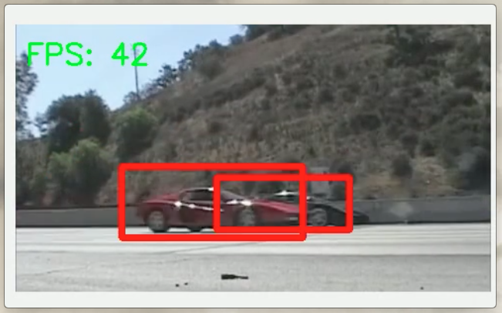
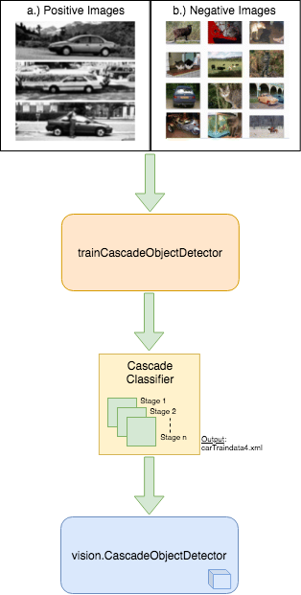
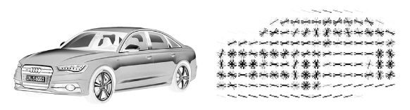
Vehicle Detection using Cascade Classifier Based on HOG Features
Introduction
Our Working Prototype
Conclusions
Vehicle detection is an integral part of intelligent transportation machines such as fully autonomous vehicles i.e. self-driving cars and trucks with level 5 autonomy and semi -autonomous vehicles i.e. vehicles with level 3+ autonomy. The objective of our Vehicle Detection using Cascade Classifier (VDCC) based on Histogram of Oriented Gradients (HOG) features project is to detect objects of interest (vehicles) in video frames. It combines best practices from real-time image processing and pattern recognition techniques of images captured from an image sensor (camera).
HOG features capture the shape information of an object and is considered to be robust for local shape variations. Cascade Classifiers are trained with several hundred "positive" sample views of different vehicles and arbitrary "negative" images of the same size and image type. After the classifier is trained, our algorithm uses this trained model along with HOG features to perform vehicle detection in real-time on the video stream obtained from the image sensor.
Our design of Vehicle Detection using Cascade Classifier (VDCC) based on Histogram of Oriented Gradients (HOG) features prototype utilizes hardware and real-time image processing to detect objects of interest as intended. We achieved an accuracy of 93% during training and validation of our model. Real world applications of the Vehicle Detection using Cascade Classifier based on HOG Features prototype includes autonomous driving, site safety, traffic control, to name a few.
System Design Overview
Histogram of Oriented Gradients
In this technique, we group a certain number of pixels into cells instead of accessing the gradient direction of each pixel. We then group the computed gradient direction into its respective orientation bin. At the end, we sum up the gradient magnitude for each sample. Stronger the gradient, greater the weight of their bins. Eventually, we get a structure of the image as shown in an example below:

